Slide 1
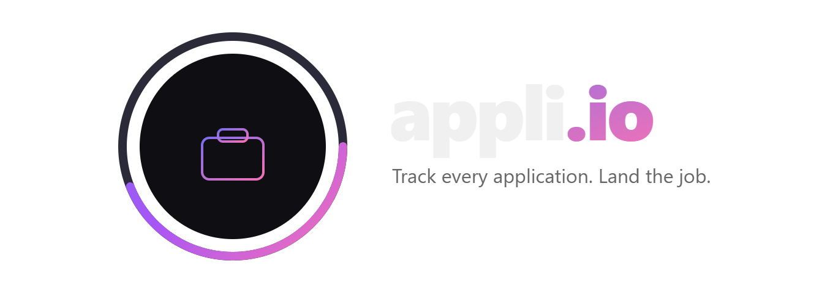
Presented to Transcend UW · 2026
1 / 10

Slide 2
WHY NOW
The job market has never been more overwhelming.
📈
🤖
📬
Application volume is exploding
AI is now cheap enough
Gmail is universal
Job seekers now send 100+ applications per cycle to compete. The volume is too high to track manually.
LLMs like DeepSeek V3 can classify emails for fractions of a cent. This infrastructure didn't exist two years ago.
Nearly every job seeker uses Gmail. It holds the full paper trail of their search — we just need to read it.
Spreadsheets and platform-specific trackers were built for a different era. Appli.io is built for now.
2 / 10

Slide 3
PROBLEM STATEMENT
Job seekers are flying blind through their own search.
"I applied to 80 companies last month. I can't remember half of them — or if any wrote back."
🗂️
🔒
🔕
Spreadsheets don't scale
Platform trackers are silos
Missed opportunities
Manual entry takes hours. People stop updating after week one. You can't track what you don't log.
Jobright and Teal only see applications on their platform — a fraction of where people actually apply.
A rejection slips by unread. A follow-up window closes. An interview invite buried under newsletters.
3 / 10

Slide 4
SOLUTION
One extension. Every application. Zero manual work.
1
2
3
4
Connect Gmail
AI Classifies
Dashboard fills in
Go deeper
OAuth2 read-only. Pull up to a year of application emails in one click.
→
A local LLM reads each email and assigns Applied, Interview, Offer, or Rejected with a reason.
→
Company, role, status, and date populate automatically. Filterable and always current.
→
Resume diagnostic, interview simulator, company deep scan, and AI follow-up generator built in.
Auto email sync
AI classification
Resume diagnostic
Interview simulator
Company deep scan
Follow-up generator
Greenhouse · Lever · Workday · Ashby
4 / 10

Slide 5
DEMO
See it in action.
Appli.io Debut - YouTube
5 / 10

Slide 6
REVENUE MODEL
Freemium to premium.
Tier
Price
What's included
Free
$0
Gmail sync, dashboard, up to 30 days of history, auto-log on job boards
Pro
$9.99/mo
Full year history, resume diagnostic, interview simulator, company deep scan, AI follow-up generator, unlimited LLM classifications
Annual
$79/yr
Everything in Pro — 34% savings. Targets serious job seekers in active search cycles.
1,000 paying users at $9.99/mo = $9,990 MRR · Low churn — users stay active for their entire search cycle.
6 / 10

Slide 7
TRACTION
We already built it.
✅
🧠
📄
🎤
Working MVP
AI pipeline live
Resume diagnostic
Interview simulator
Full Chrome extension with Gmail sync, AI classification, and live dashboard.
Two-stage classifier: fast keyword pass + DeepSeek V3 LLM with retry, cache, and queue.
Accepts PDF, DOCX, TXT. Scores every bullet 1–10 with AI-rewritten alternatives.
AI interviewer with speech recognition, TTS, webcam input, and filler word tracking.
4
5
$0
Job boards auto-logged
(Greenhouse, Lever, Workday, Ashby)
AI-powered features
shipped at launch
Infrastructure cost
in MVP phase
7 / 10

Slide 8
MARKET OPPORTUNITY
A massive market with no dominant solution.
LinkedIn Premium generates $1.7B/yr from job seekers
alone — and it doesn't track a single application.
TAM
SAM
$28B
SOM
$4.2B
There is no dominant AI-native tracker in the Chrome Store today. The window is wide open.
$180M
Global HR & job
seeker tools market
US Gmail + Chrome
active job seekers
College students
& recent grads
Year 1 target: college students & recent grads (SOM)
8 / 10

Slide 9


THE TEAM
Built by people who lived the problem.
👤
Kobe Uko
Pranab Adhikari
Co-Founder · Software Engineer
Co-Founder · Software Engineer
CS major at University of Wisconsin-Madison. Serial Job applier.
CS major at University of Wisconsin-Madison. 2x UW-Madison Transcend Participant. Love for Start-ups.
Both founders went through the exact grind Appli.io solves — hundreds of applications, lost in their own inbox.
9 / 10

Slide 10
ROADMAP
Where we're going.
Q2 2026
Chrome Store launch + beta users
Public release, onboard first 500 users, gather feedback on classification accuracy and UX.
Q3 2026
Pro tier + monetization live
Stripe integration, Pro unlock for resume diagnostic, interview simulator, and deep scan. First revenue.
Q4 2026
University career center partnerships
B2B licensing to career centers — institutions pay per-student to give their grads an edge.
2027
Outlook + mobile companion
Expand beyond Gmail. Mobile app for status checks and interview prep on the go.
10 / 10

